Slide 1
Machine Learning in the Geosciences
ESS 469/569 Intro Class
Marine Denolle mdenolle@uw.edu

Slide 2
Introductions
YOUR PHOTO
Instructor: NAME (email)
PhD. in X
Prof at Y
Computing: self-taught computing and ML
Research: very cool frontier research
Discovery-based science rooted in data and physical systems
Machine Learning in my discipline: noise, signal, high-dimensional and bigdata
Repeat for TA
Marine Denolle mdenolle@uw.edu

Slide 3
Introductions
Let’s go around the room!
Name
class year
1 sentence about you
Marine Denolle mdenolle@uw.edu

Slide 4
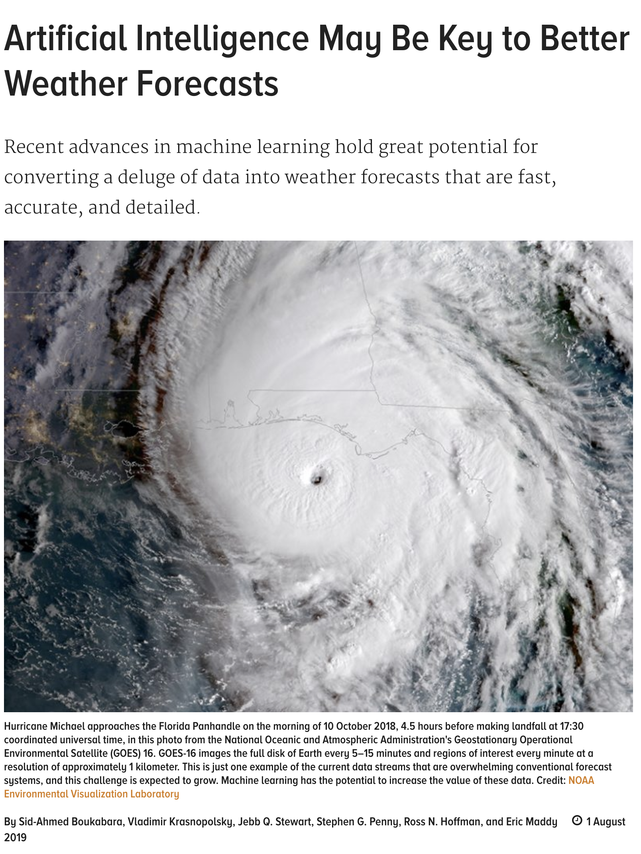
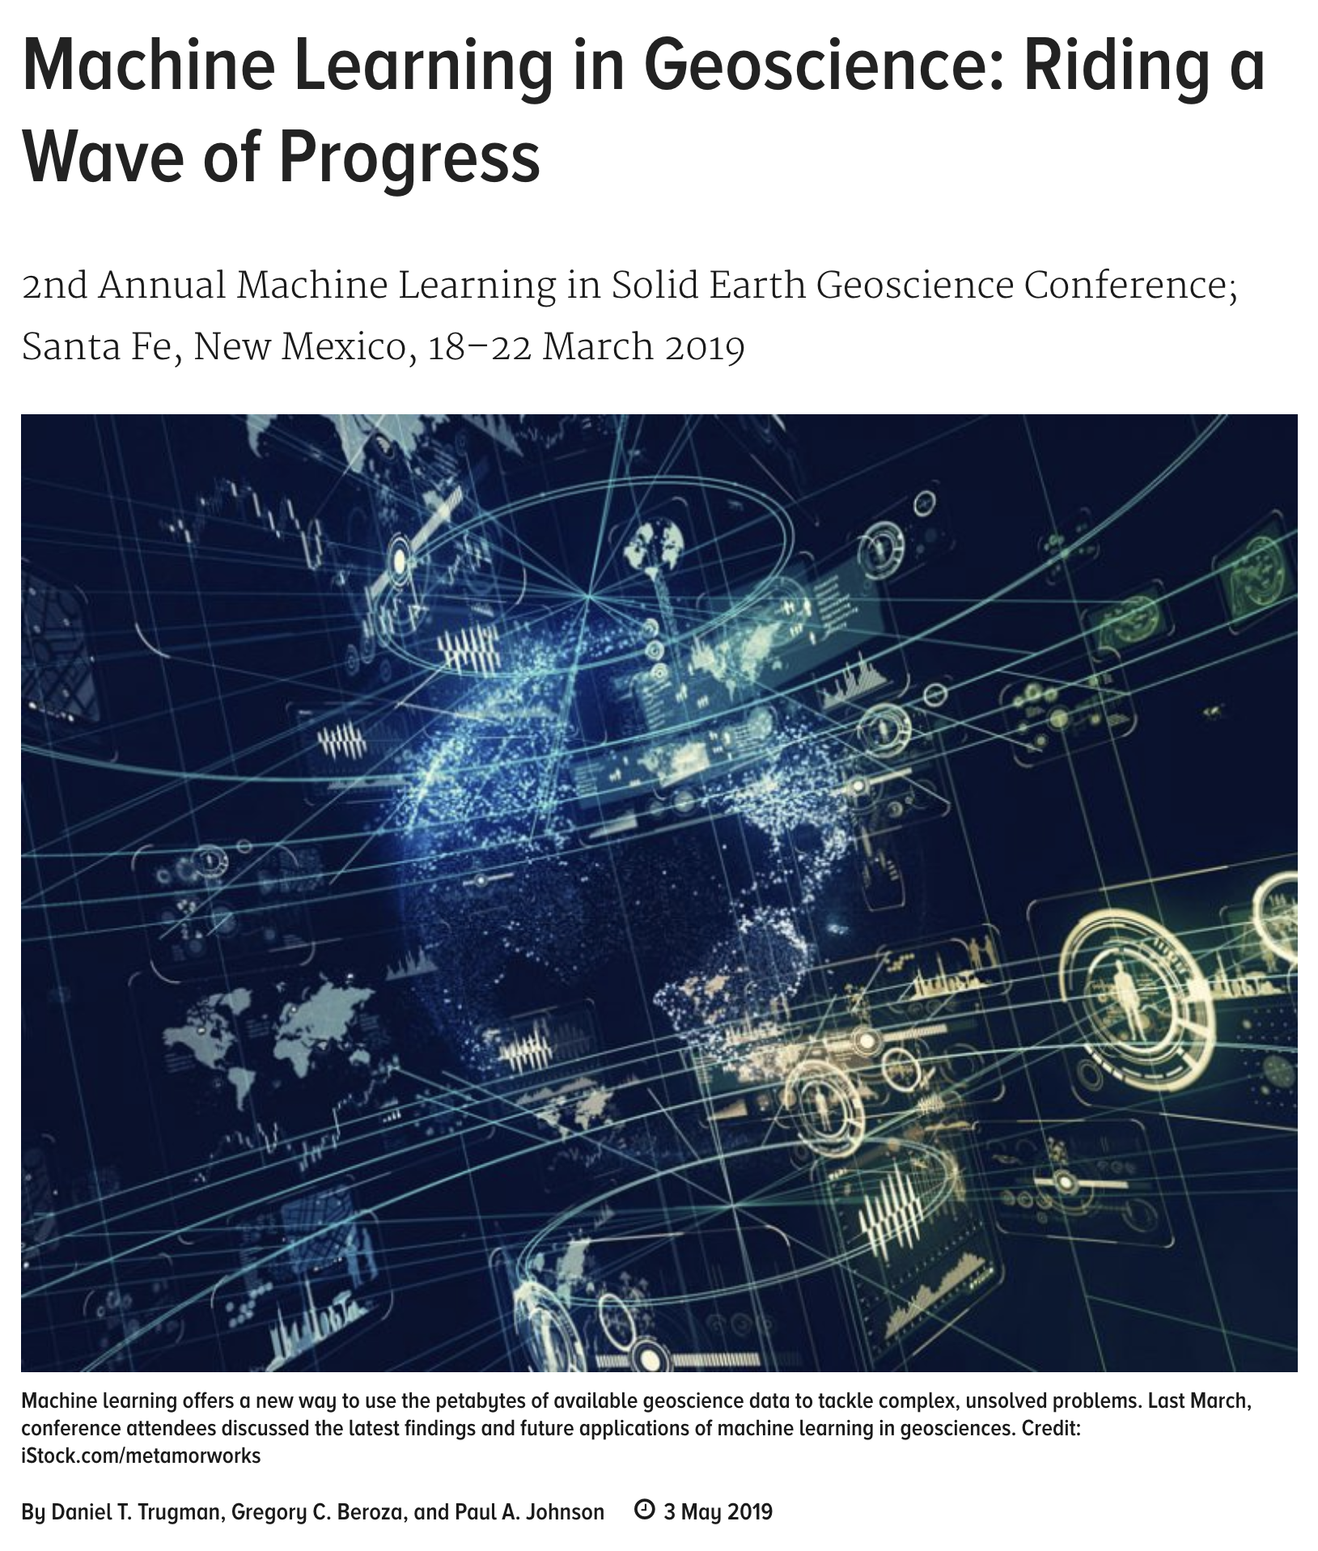
Marine Denolle mdenolle@uw.edu

Slide 5
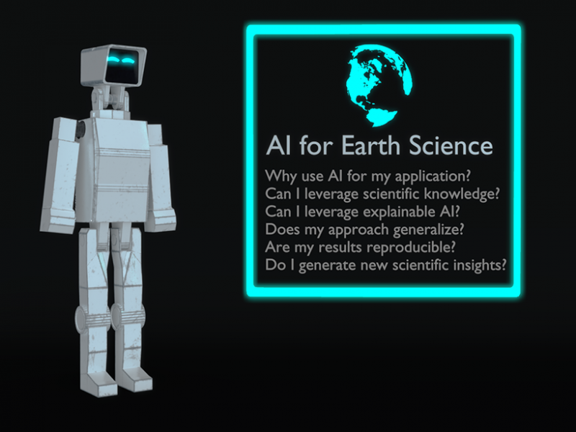
EOS, Niels Uphoff 2019
Marine Denolle mdenolle@uw.edu

Slide 6
Scientists are revitalized
“We envision Earth AI to be a huge combination of systems to automatically monitor and forecast nature, help adapt human society to environmental changes, guide humans to make planet-wise policies and decisions, and protect us from geohazard.”
Sun et al., 2022
Marine Denolle mdenolle@uw.edu

Slide 7
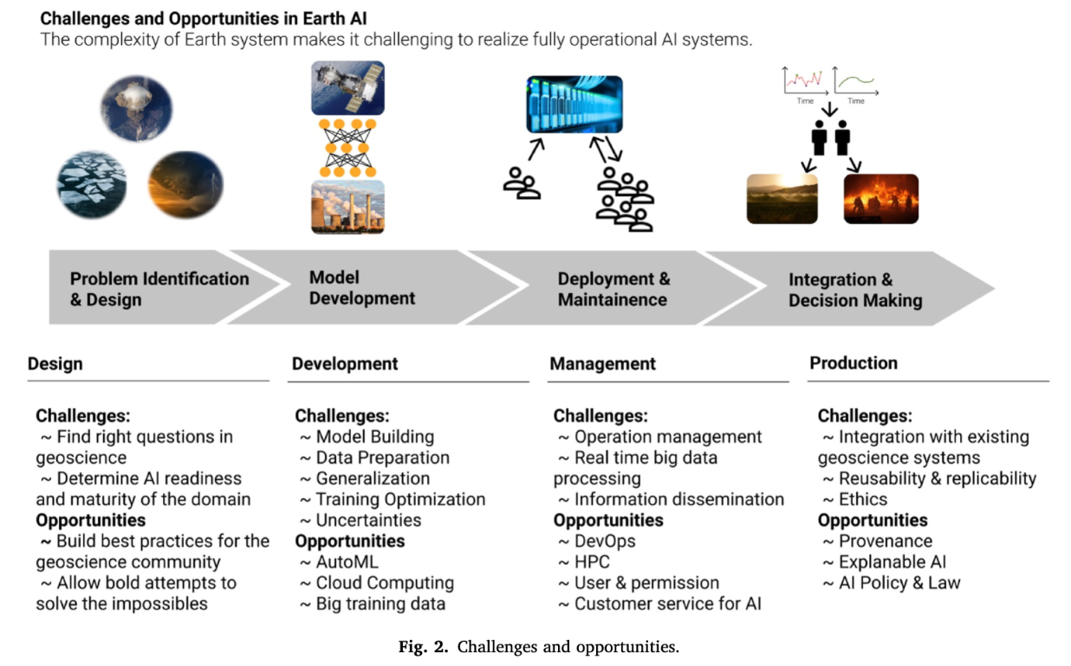
Sun et al, 2022
Marine Denolle mdenolle@uw.edu

Slide 8
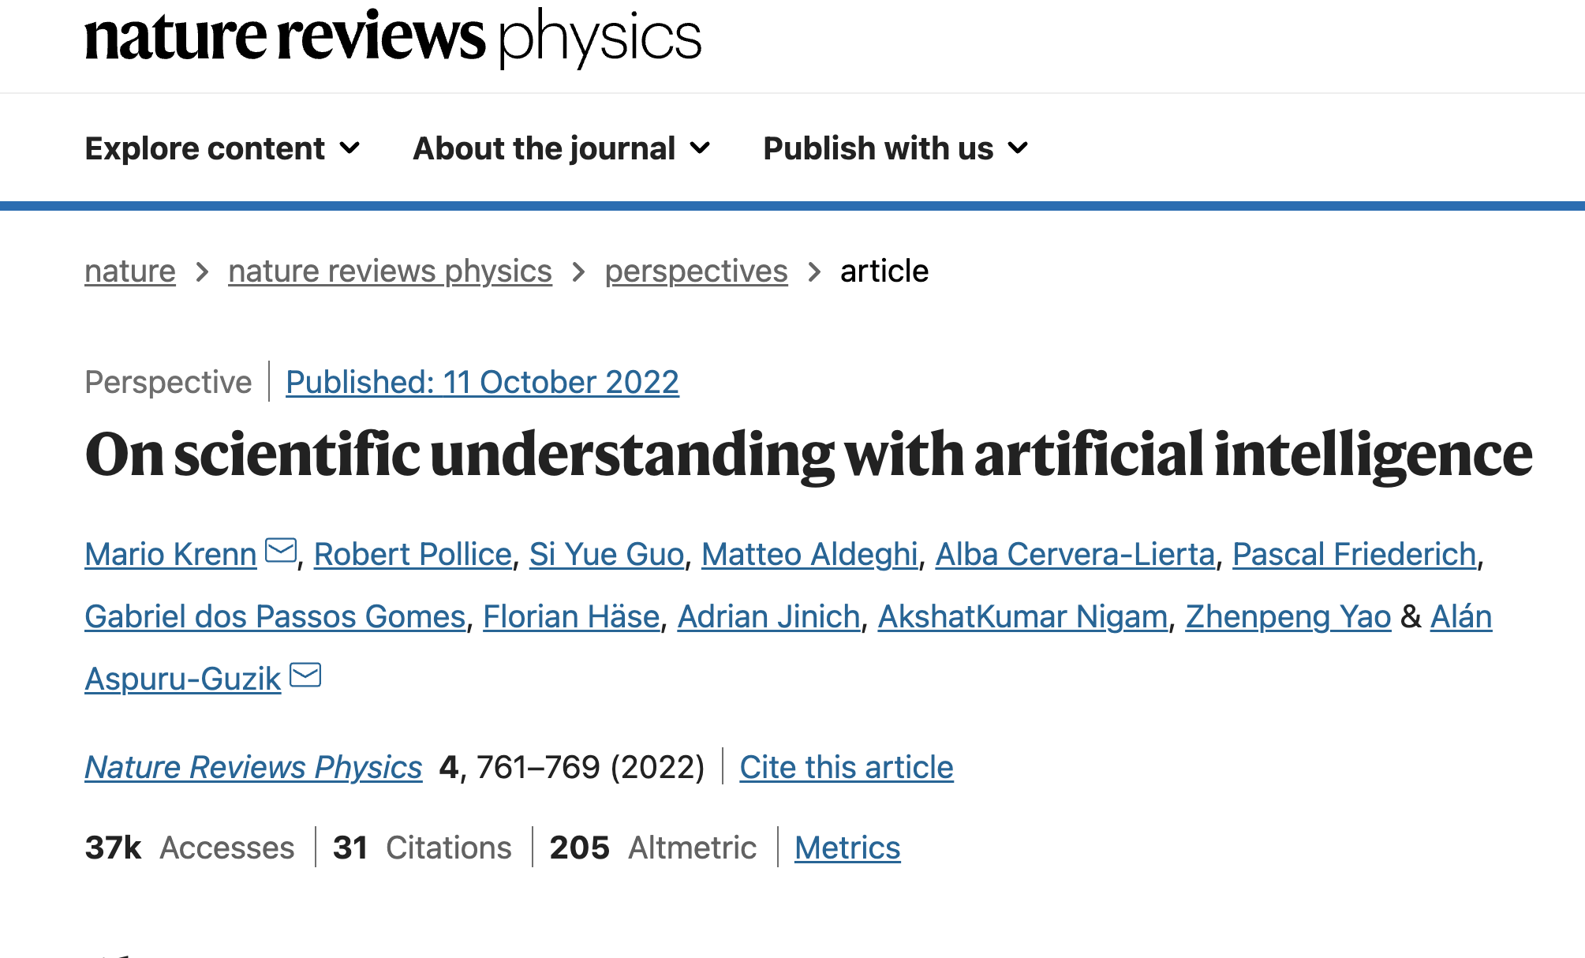
Can AI help scientists (and not just engineers) ?
Marine Denolle mdenolle@uw.edu

Slide 9
Scientific Discovery vs Scientific Understanding
“Whether an AI that can rediscover physical laws and concepts would also be capable of contributing to new scientific understanding.”
“many discoveries in physics occur before (sometimes long before) a theory or explanation, which provides scientific understanding, is uncovered. “
Marine Denolle mdenolle@uw.edu

Slide 10
Weak ML achieves improved prediction quality with a larger amount of training data.
Michie, D. in Proc. 3rd European Conference on European Working Session on Learning, 107–122 (ACM, 1988).
Marine Denolle mdenolle@uw.edu

Slide 11
Weak ML achieves improved prediction quality with a larger amount of training data.
Strong ML approaches require providing a symbolic representation of their hypothesis, for example, via Boolean (logical) expressions or mathematical equations.
Michie, D. in Proc. 3rd European Conference on European Working Session on Learning, 107–122 (ACM, 1988).
Marine Denolle mdenolle@uw.edu

Slide 12
Weak ML achieves improved prediction quality with a larger amount of training data.
Strong ML approaches require providing a symbolic representation of their hypothesis, for example, via Boolean (logical) expressions or mathematical equations.
Ultrastrong ML approaches require that the algorithm teaches the human operator such that the human performance is improved compared with the human learning from data alone.
Michie, D. in Proc. 3rd European Conference on European Working Session on Learning, 107–122 (ACM, 1988).
Marine Denolle mdenolle@uw.edu

Slide 13
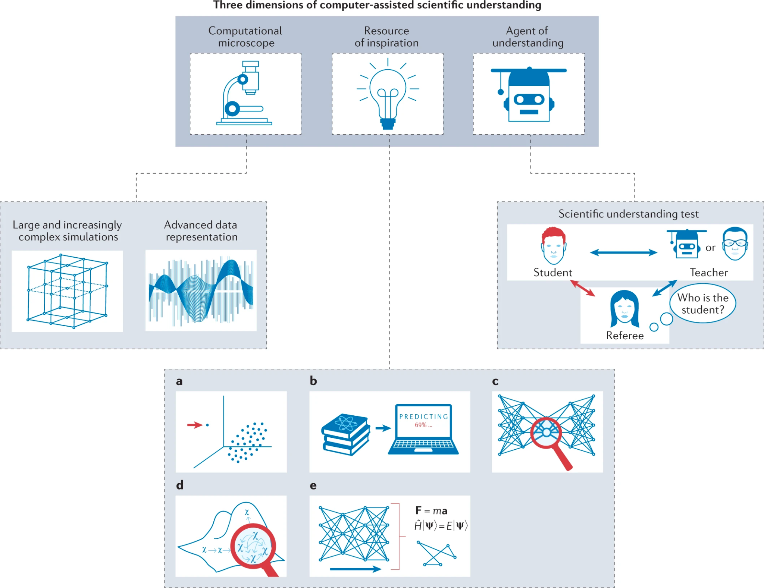
Improved observation and data discovery
Marine Denolle mdenolle@uw.edu

Slide 14
Improved observation and data discovery
2. Identifying Surprises in Data and Concepts
“Surprising and creative ideas are the foundation of advances in science.”
Marine Denolle mdenolle@uw.edu

Slide 15
Improved observation and data discovery
3. Agent for scientific understanding
2. Identifying Surprises in Data and Concepts
“Surprising and creative ideas are the foundation of advances in science.”
Marine Denolle mdenolle@uw.edu

Slide 16

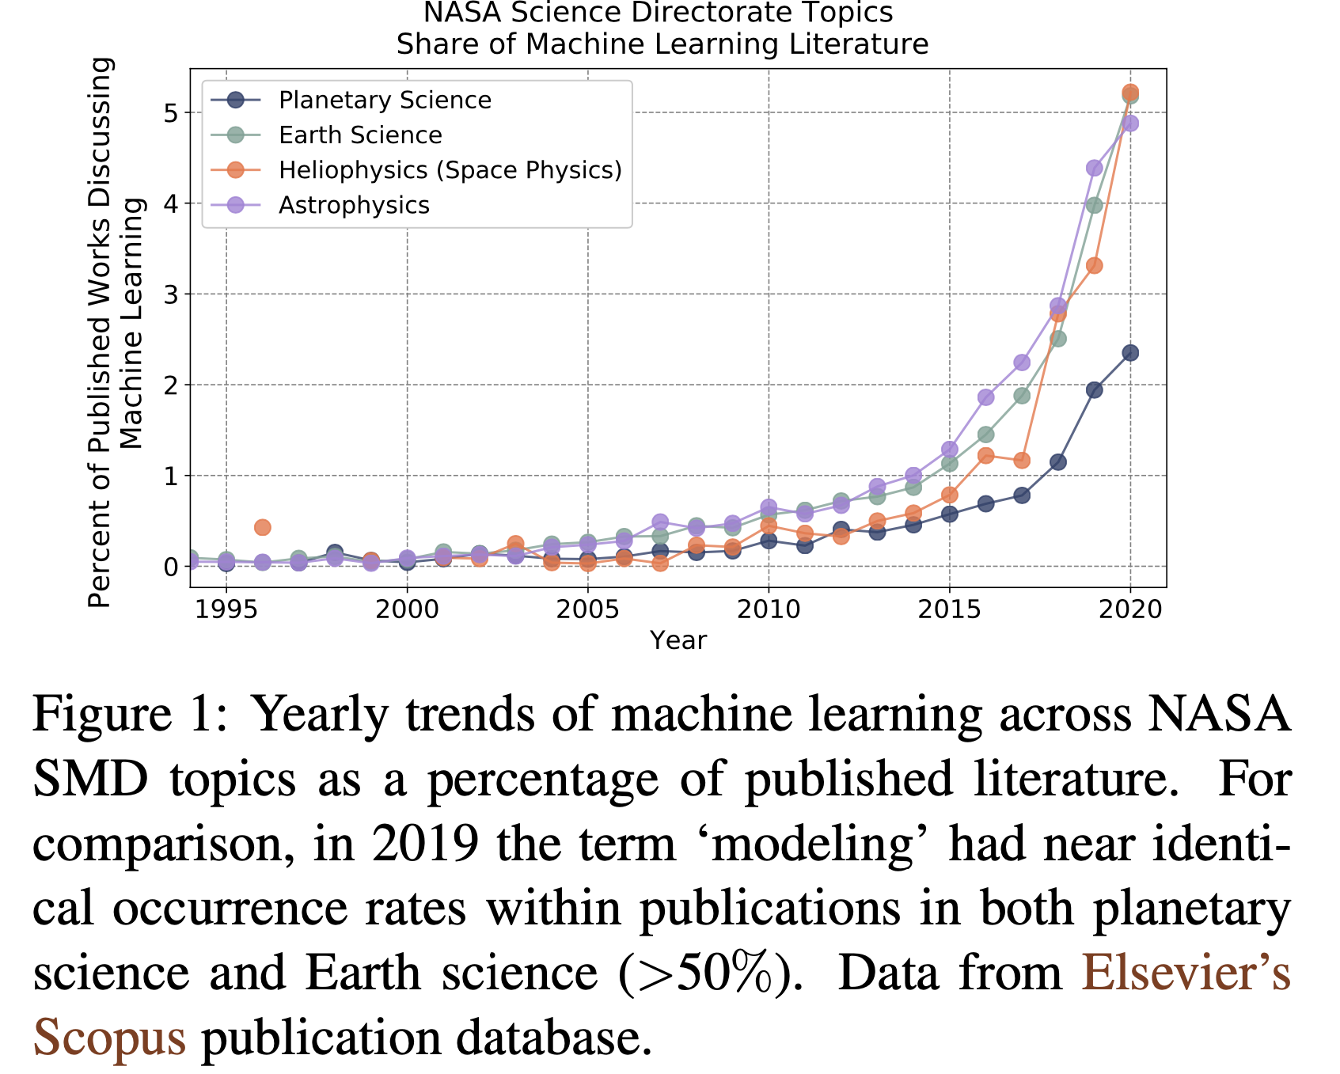
Explosion of ML-related publication
Marine Denolle mdenolle@uw.edu

Slide 17
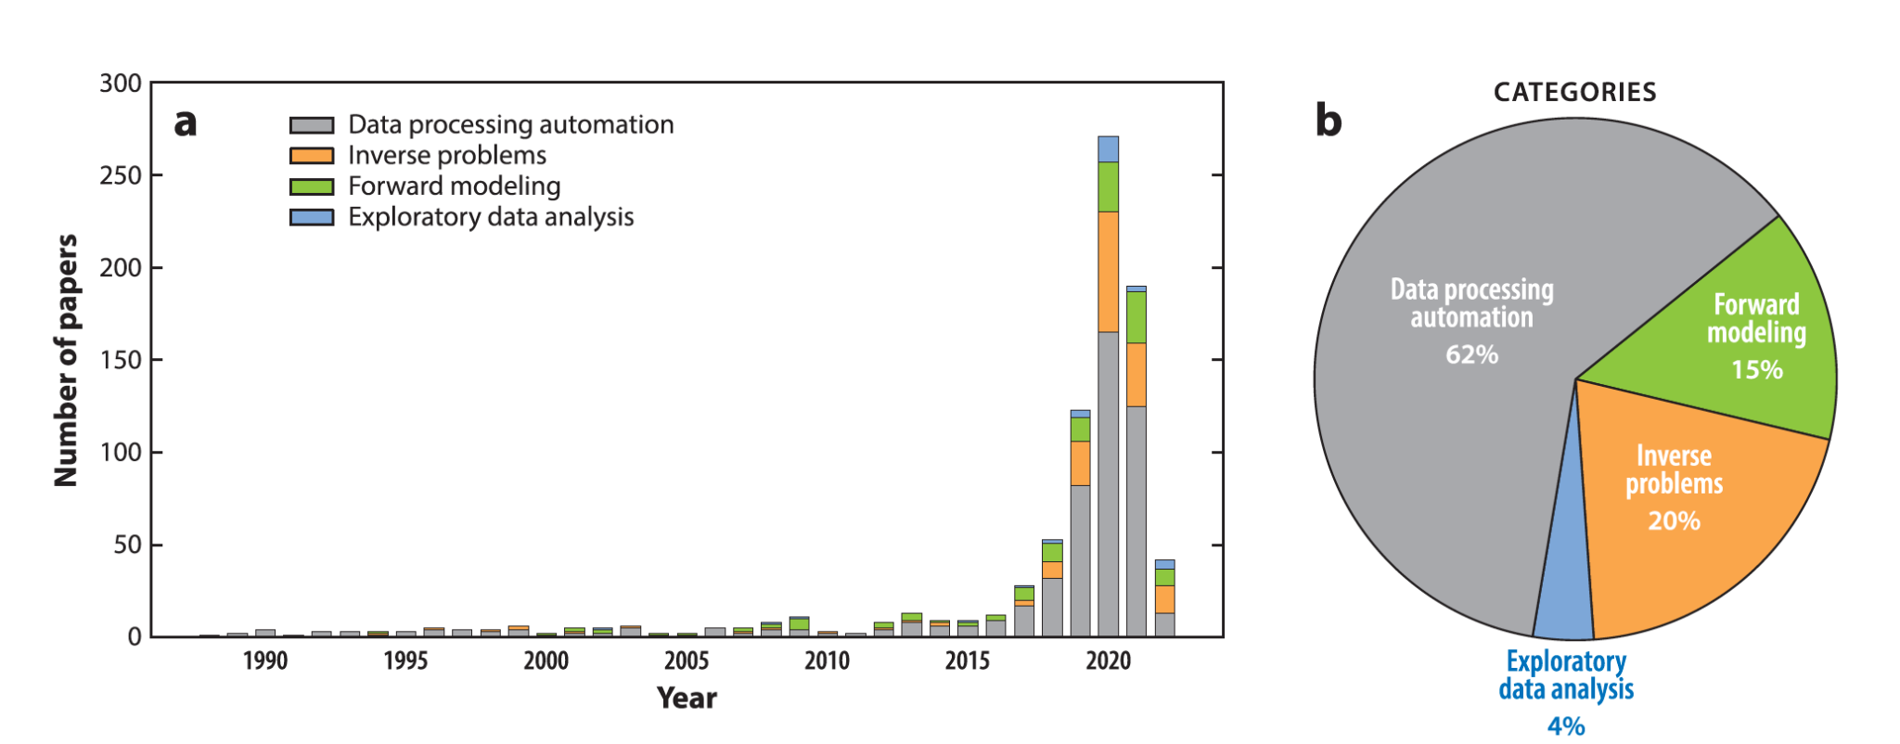
Explosion of ML-related publication
Mousavi and Beroza (2023)
Marine Denolle mdenolle@uw.edu

Slide 18
What do scientists need to learn?
What is the model learning?
How trustworthy is the prediction?
What is signal, what is noise?
How can I guide the model to respect physical laws?
Marine Denolle mdenolle@uw.edu

Slide 19
What do scientists need to learn?
What is the model learning?
How trustworthy is the prediction?
What is signal, what is noise?
How can I guide the model to respect physical laws?
How can I use Artificial Intelligence (AI) as an Intelligent Assistant (IA)?
Can we learn physical processes from data using AI/ML ?
Marine Denolle mdenolle@uw.edu

Slide 20
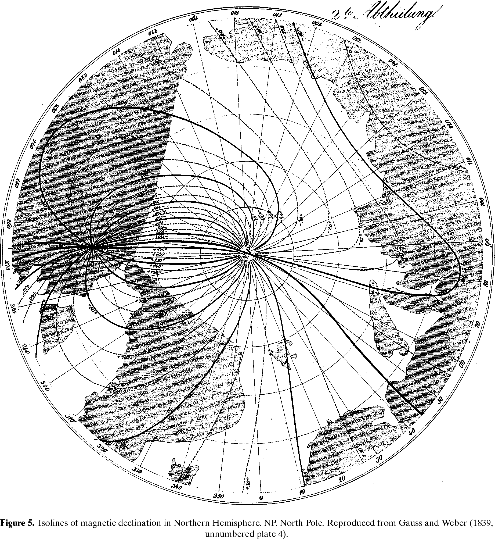
What is model fitting?
Akshay Mehra akmehra@uw.edu
Marine Denolle mdenolle@uw.edu
Howarth, 2001

Slide 21
What confuses or excites you about ML in geosciences?
https://pollev.com/mlgeo2024
Marine Denolle mdenolle@uw.edu

Slide 22
What confuses or excites you about ML in geosciences?
What geoscientific problem are you most excited about?
https://pollev.com/mlgeo2024
Marine Denolle mdenolle@uw.edu

Slide 23
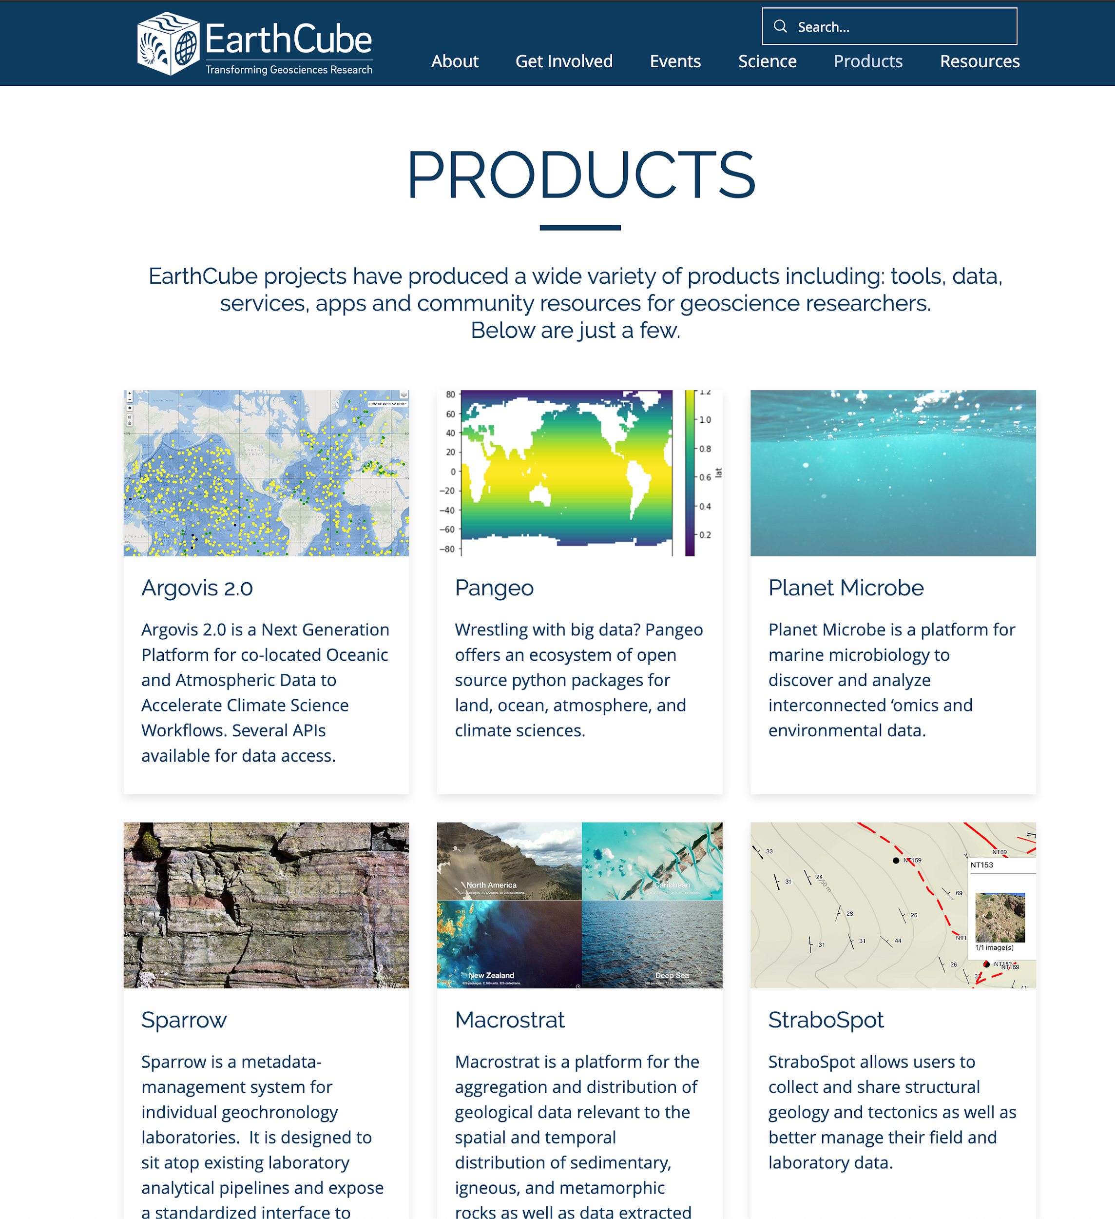

Geosciences has entered an era of big data
Marine Denolle mdenolle@uw.edu

Slide 24
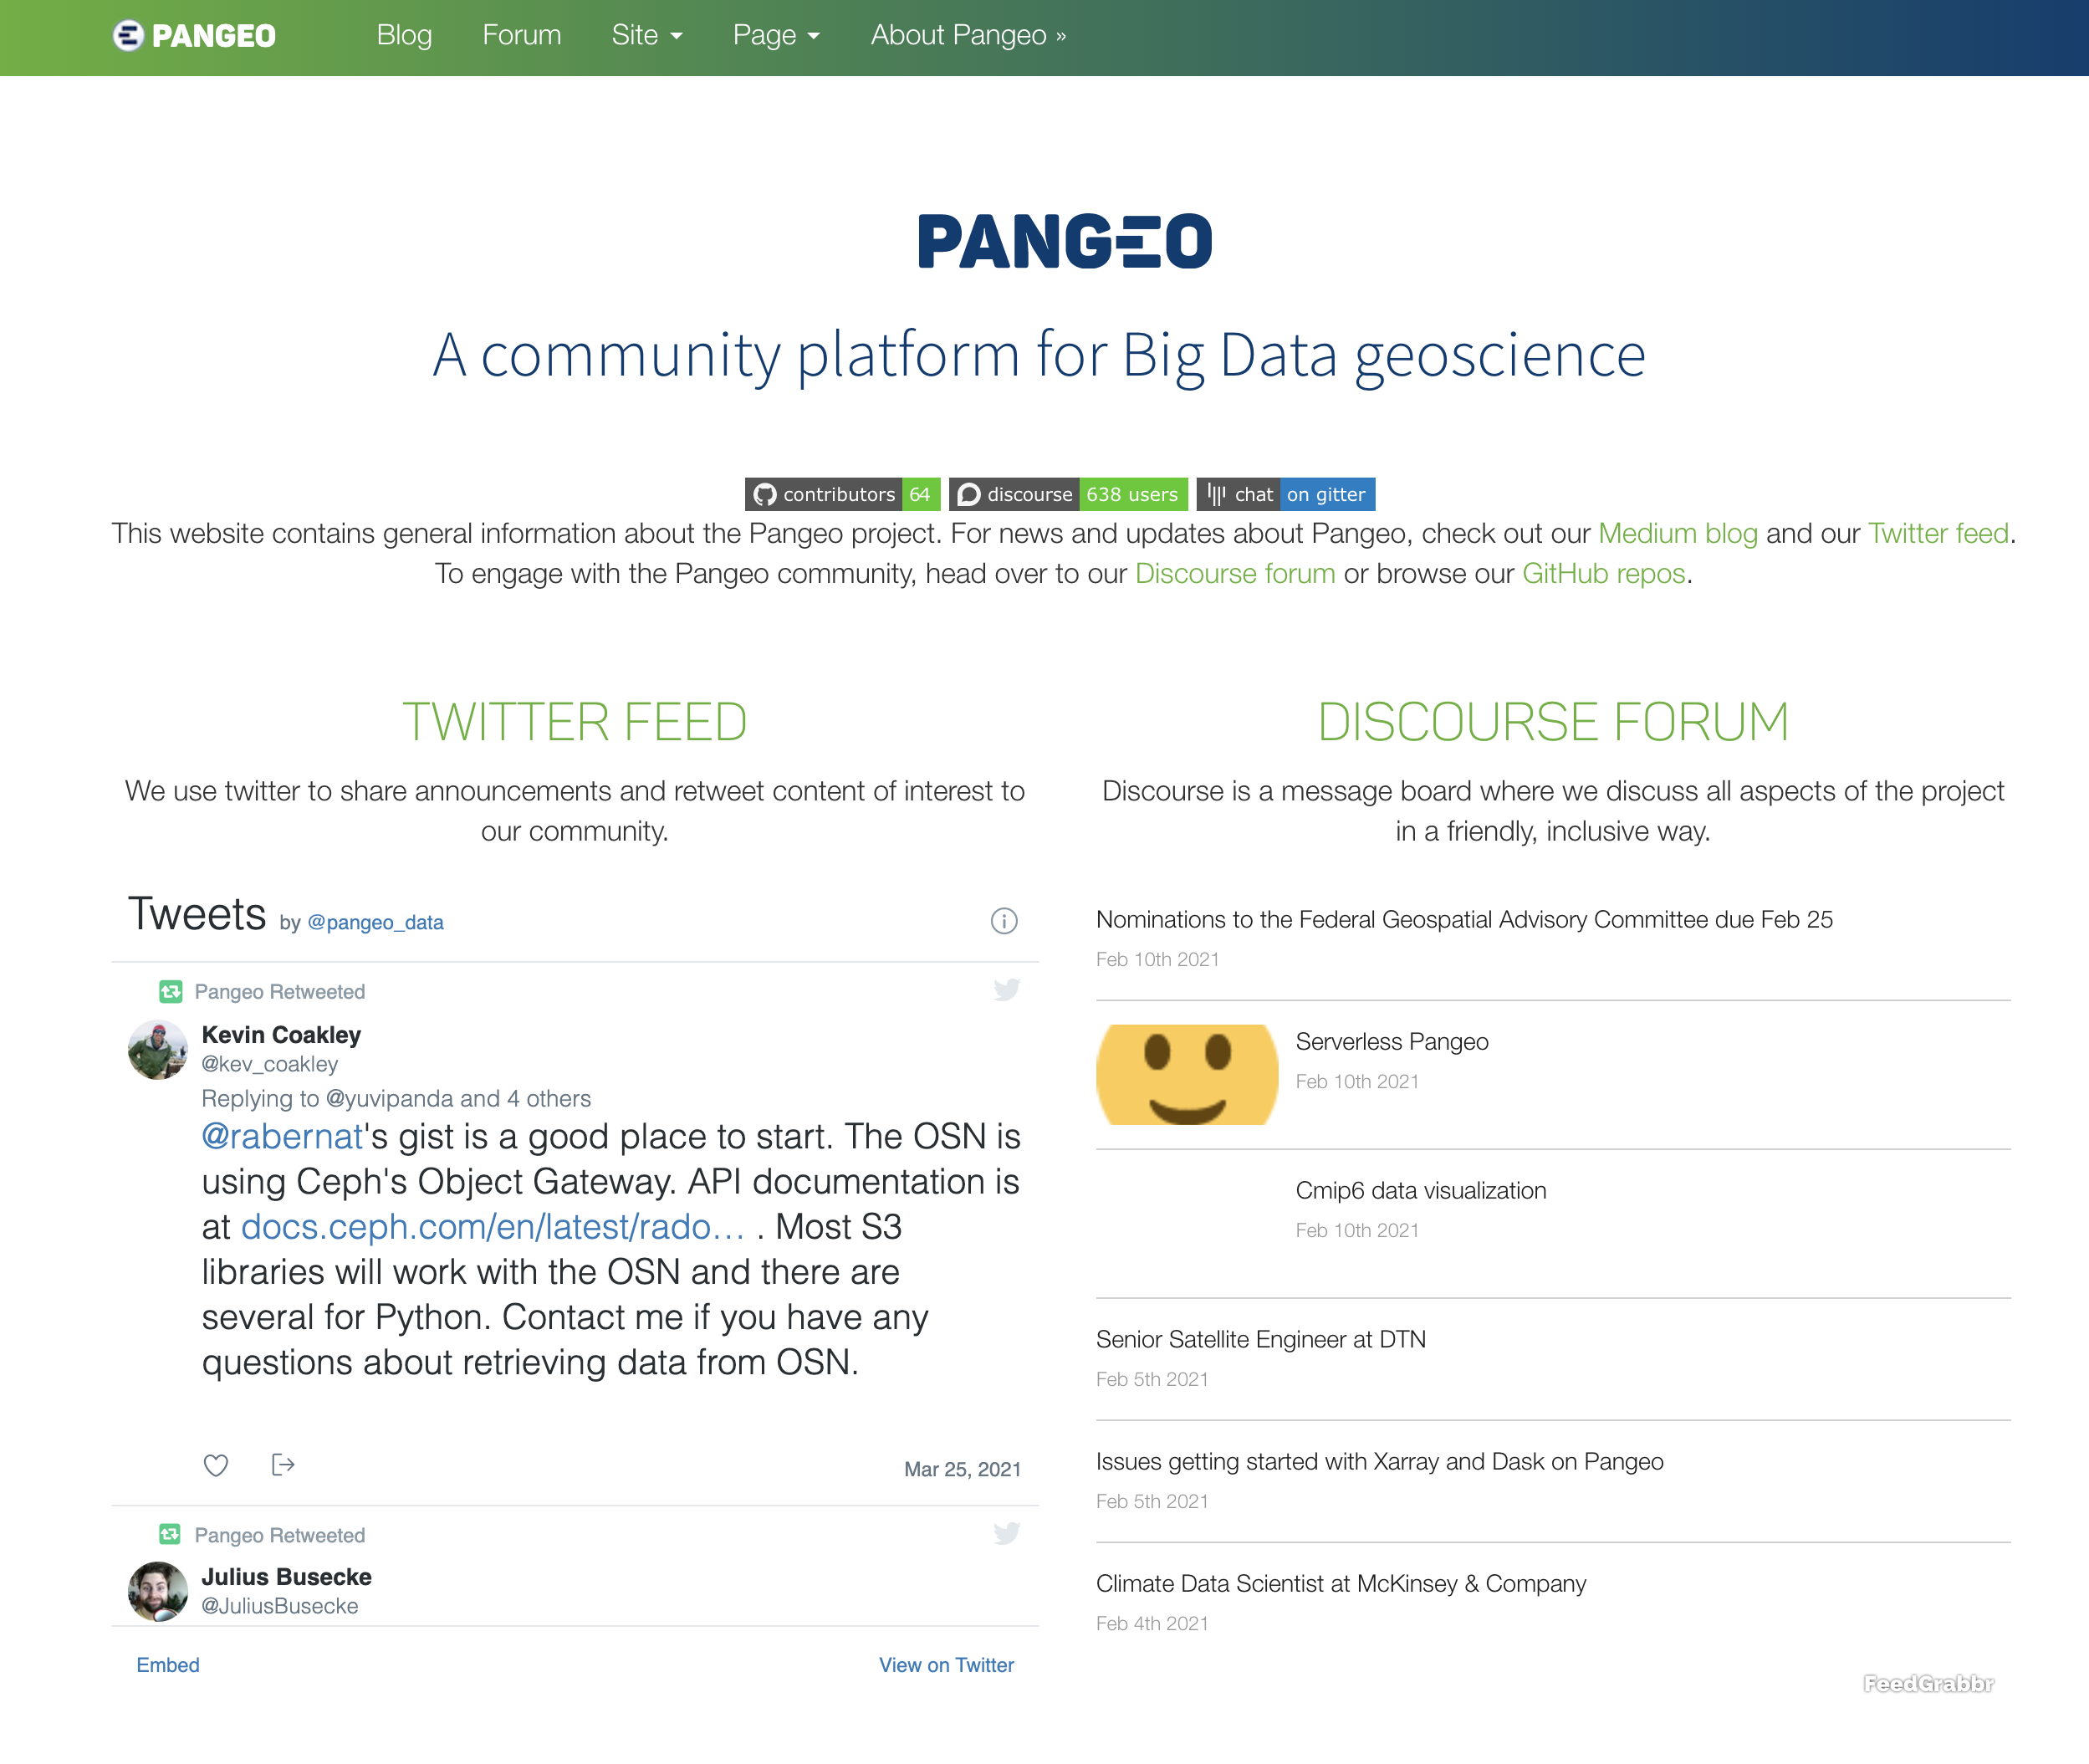
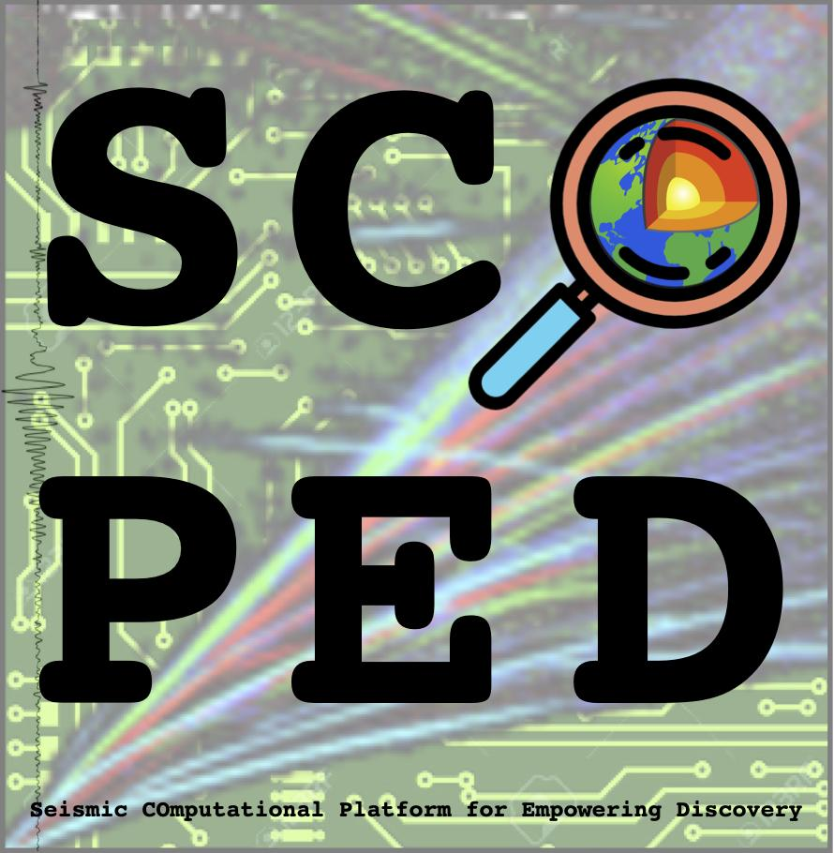
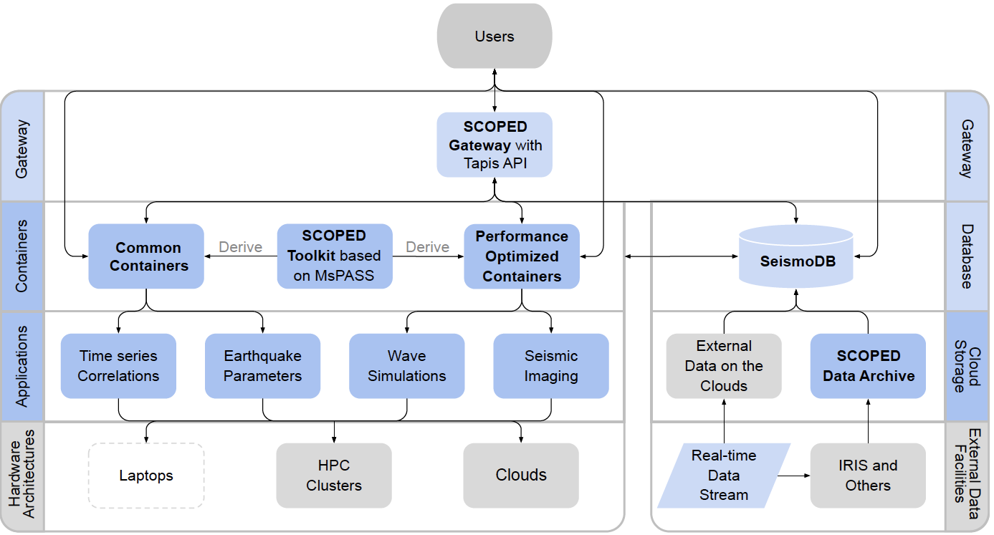
Geosciences has entered an era of big data+cloud computing
Seismic COmputational Platform for Empowering Discovery (SCOPED)
Marine Denolle mdenolle@uw.edu

Slide 25
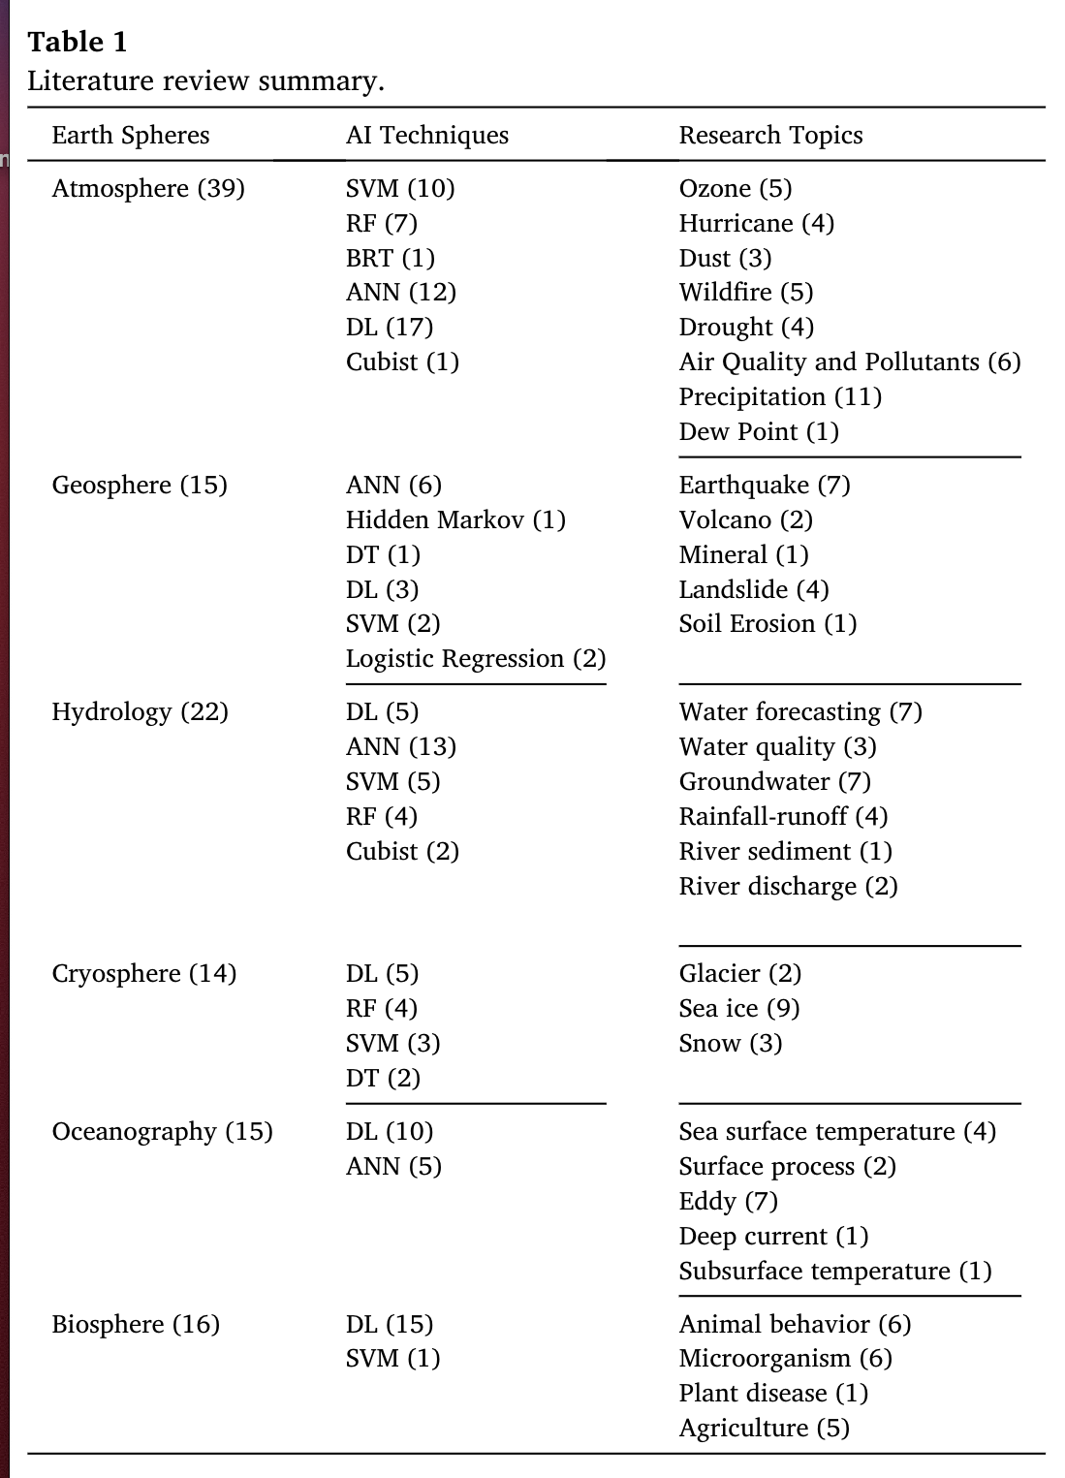
“ML could issue life-saving short-term volcano alerts in future.”
Sun et al., 2022
Marine Denolle mdenolle@uw.edu

Slide 26
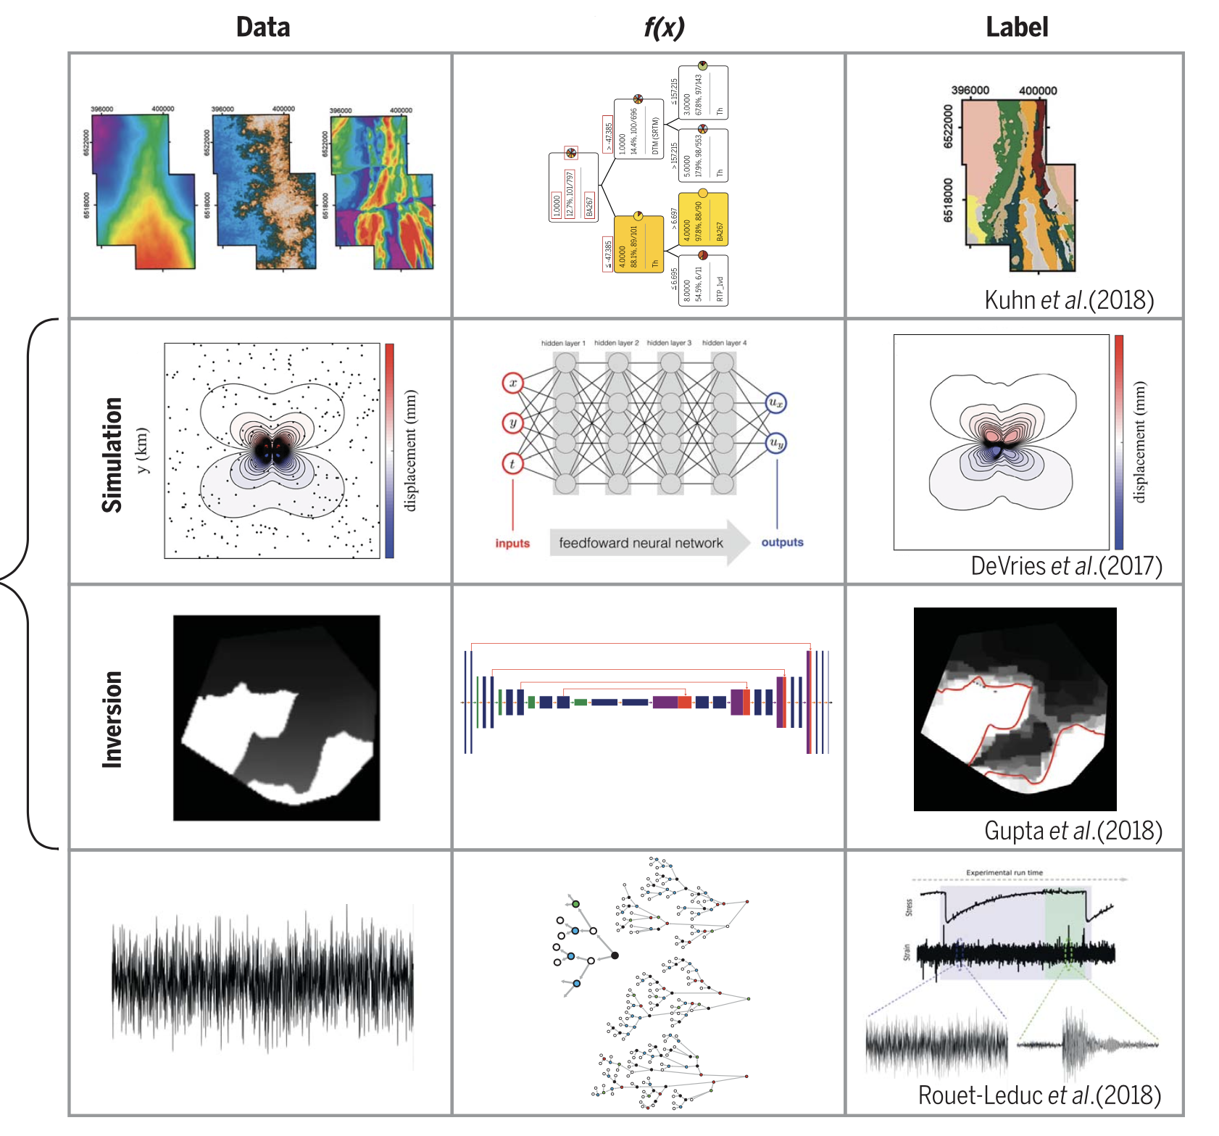
automated association
emulation of complex modeling
discovery
Bergen et al, 2019
Marine Denolle mdenolle@uw.edu

Slide 27
What ML learns
supervised | self-supervised | unsupervised
Data = f (x)
We have data.
We have x.
We learn f.
Marine Denolle mdenolle@uw.edu

Slide 28
What ML learns
supervised | self-supervised | unsupervised
Data = f (x) |  | Data = f (x)
We have data. |  | We have data.
We have x. |  | We have f (feature extraction+grouping).
We learn f. |  | We learn x.
Marine Denolle mdenolle@uw.edu

Slide 29
What ML learns
supervised | self-supervised | unsupervised
Data = f (x) | Data = f (x) | Data = f (x)
We have data. | We have data. | We have data.
We have x. | We learn f (feature extraction+grouping). | We have f (feature extraction+grouping).
We learn f. | We learn x. | We learn x.
Marine Denolle mdenolle@uw.edu

Slide 30
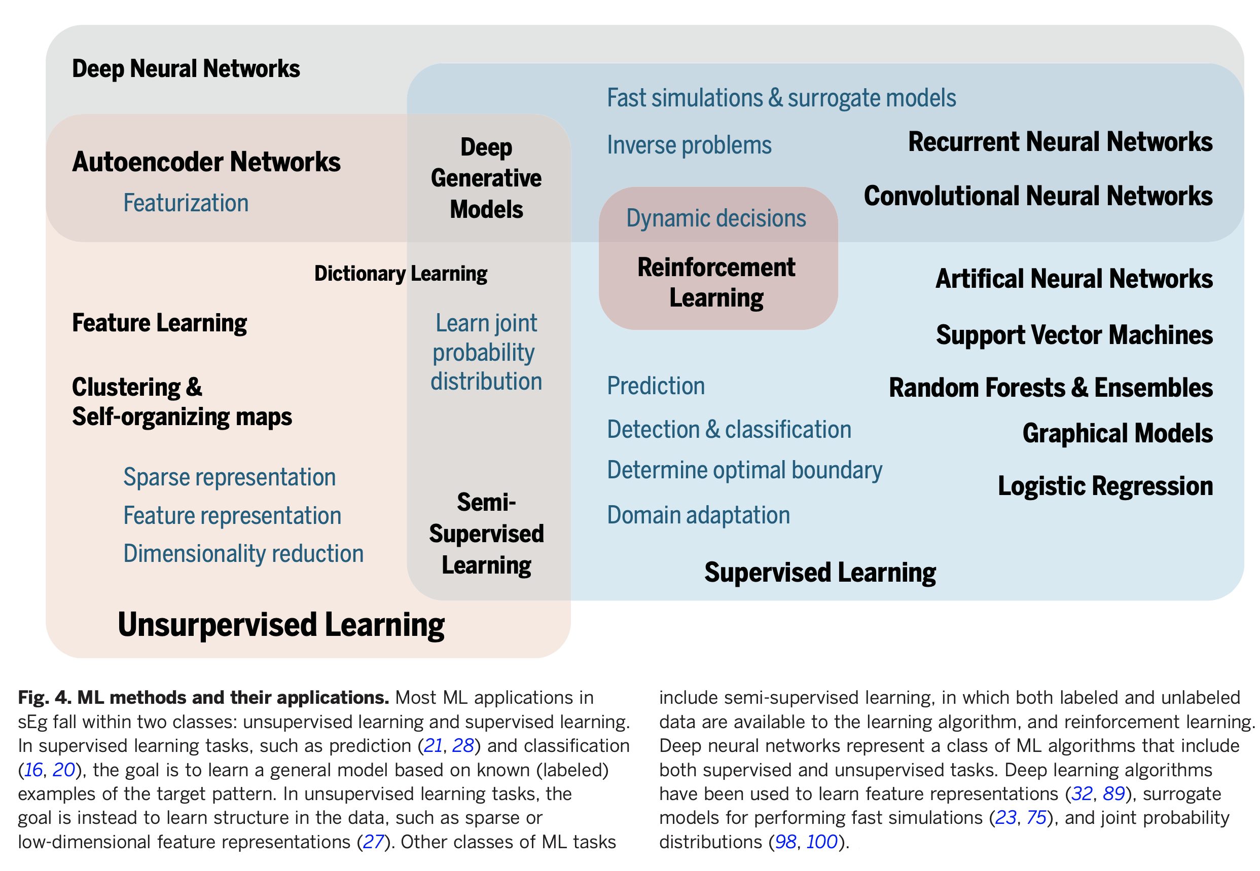
Machine learning techniques in the geosciences
Bergen et al, 2019
Marine Denolle mdenolle@uw.edu

Slide 31
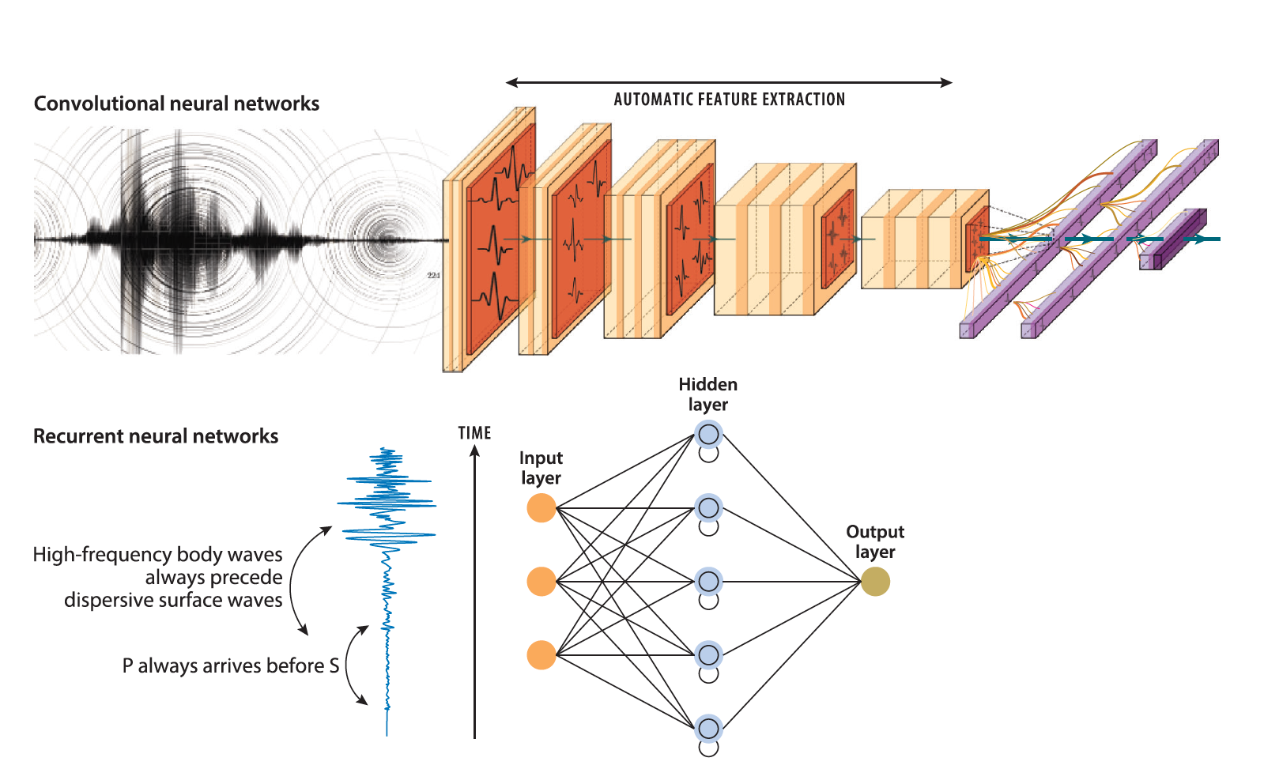
Mousavi and Beroza, 2023
Marine Denolle mdenolle@uw.edu

Slide 32
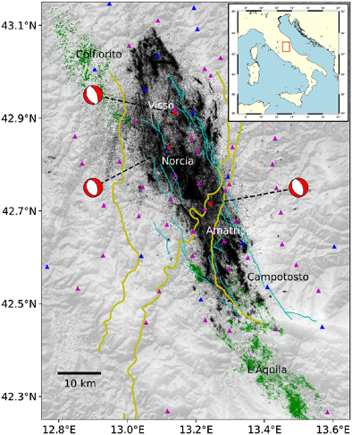
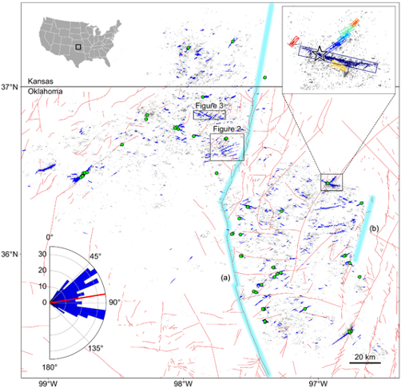
Seeing through the noise
Park et al, 2022
Tan et al, 2021
Marine Denolle mdenolle@uw.edu

Slide 33
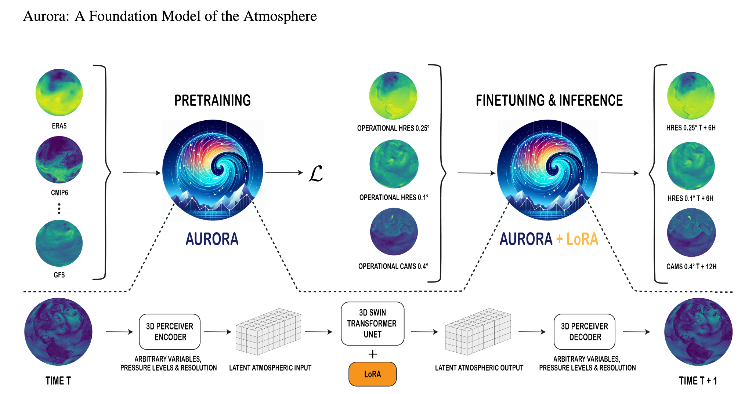
Accelerating computation of complex dynamical systems
Bodnar et al. (2024)
Marine Denolle mdenolle@uw.edu

Slide 34
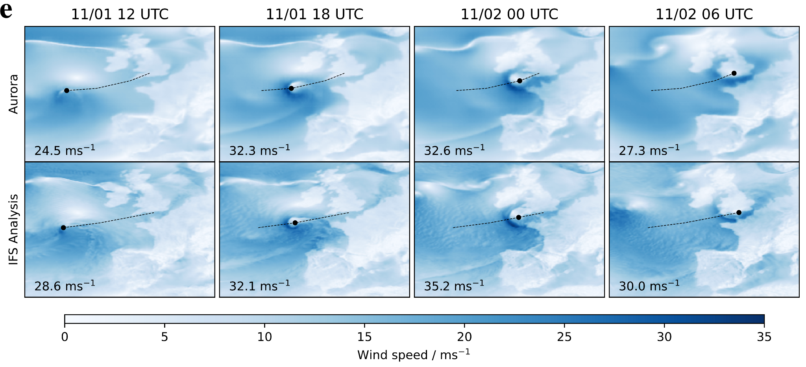
Accelerating computation of complex dynamical systems
Bodnar et al. (2024)
Marine Denolle mdenolle@uw.edu

Slide 35
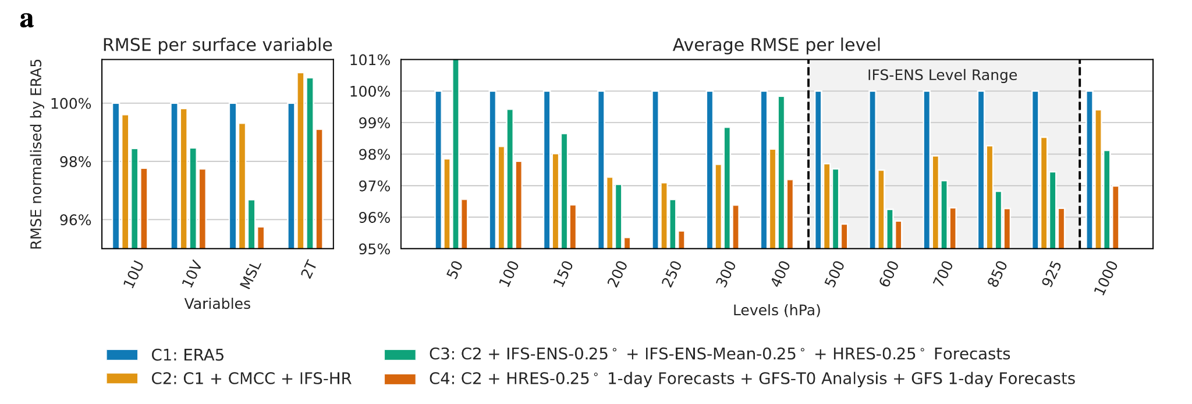
Accelerating computation of complex dynamical systems
Training with data & simulations improves performance
better
Bodnar et al. (2024)
Marine Denolle mdenolle@uw.edu

Slide 36

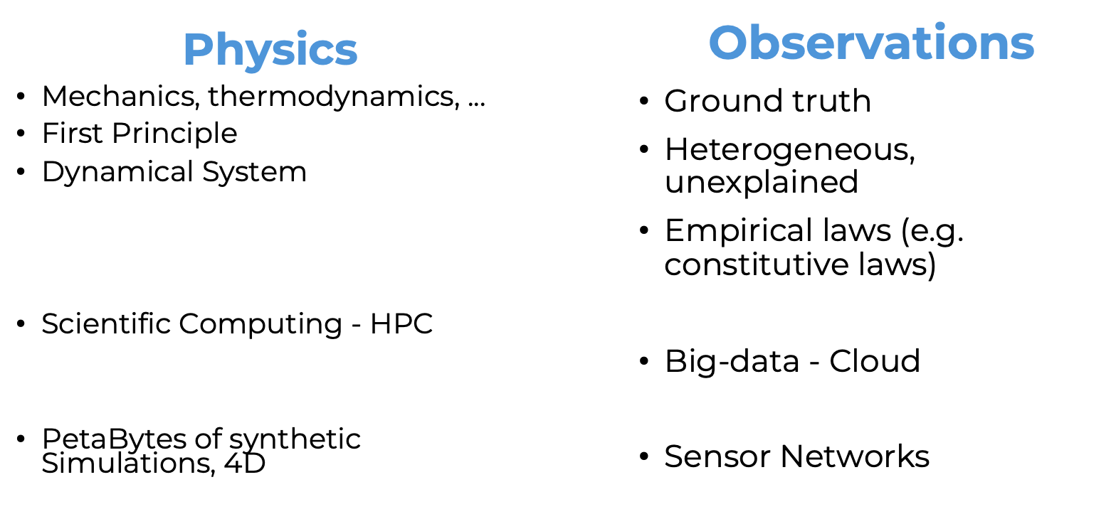
Marine Denolle mdenolle@uw.edu

Slide 37
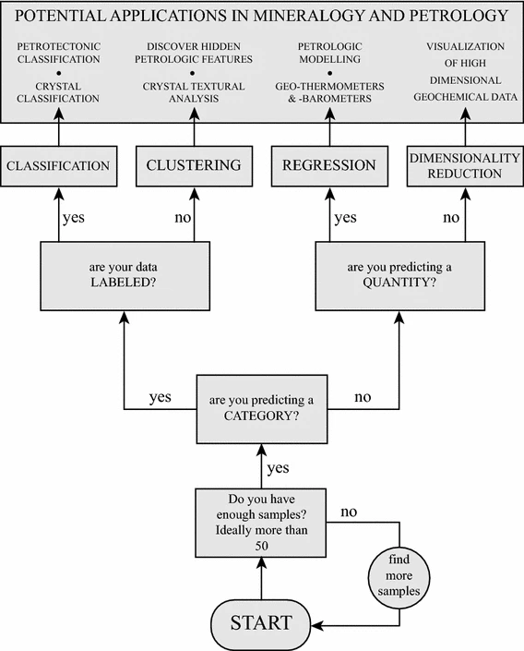
What ML technique should we use?
It depends on the data and the question.
Petrilli and Perugnini 2016
Marine Denolle mdenolle@uw.edu

Slide 38
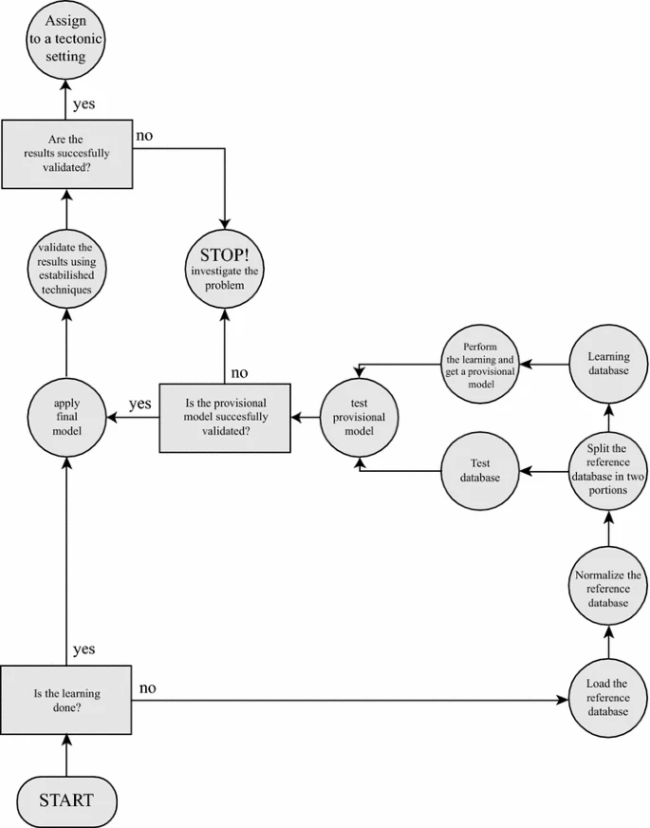
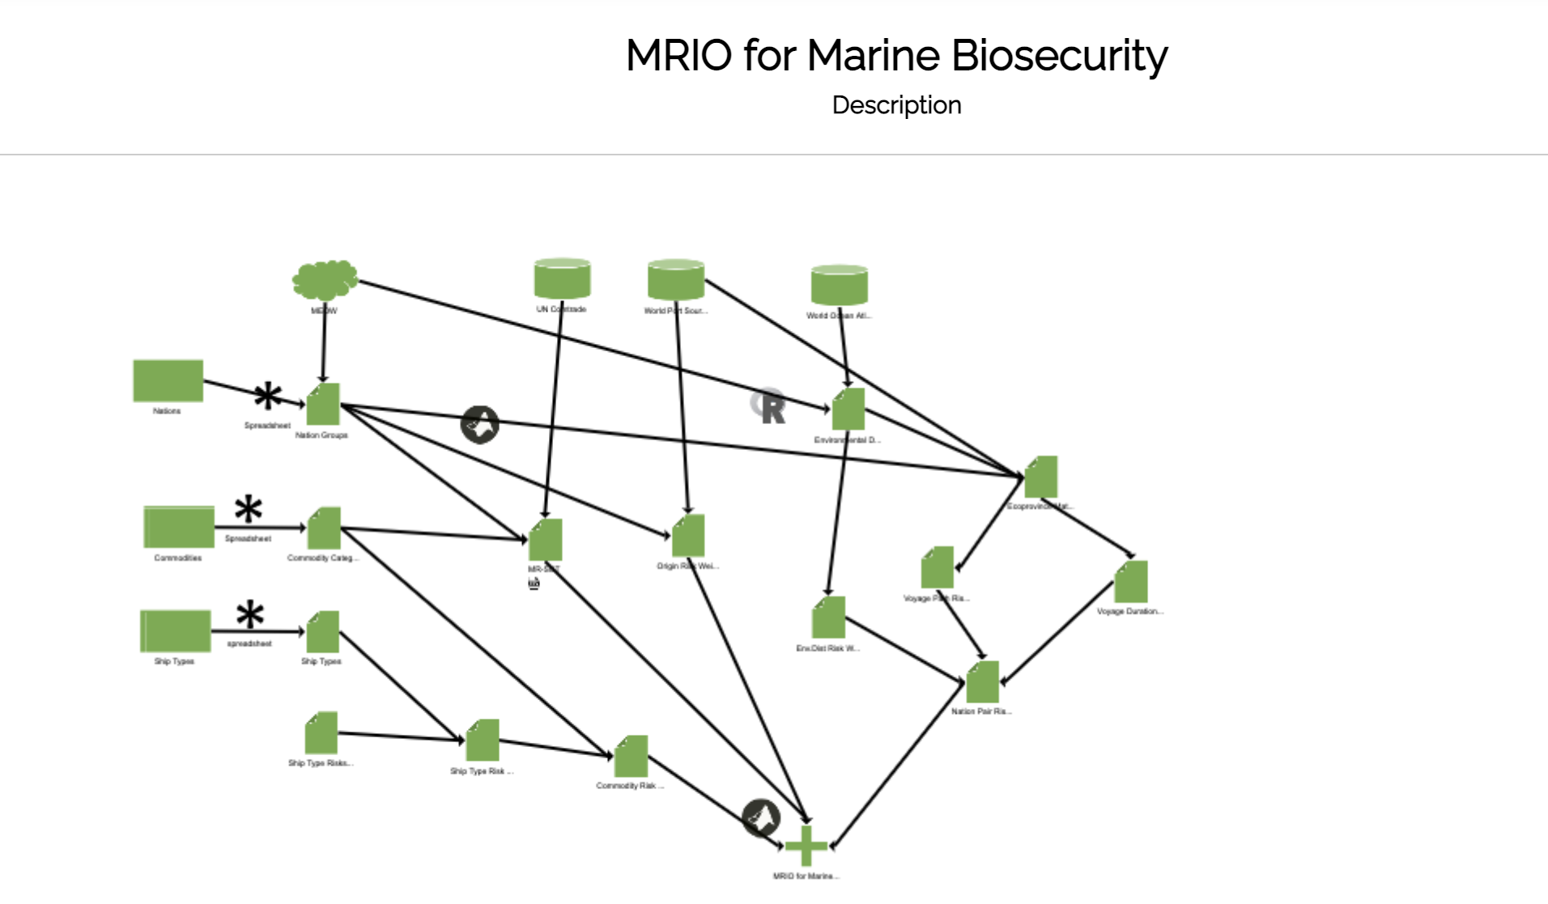
Research workflows
A scientific project can be complex.
To reproduce the results, we need to be clear and transparent in publication for others, and for ourselves.
Laying out clear scientific workflows is essential.
Petrilli and Perugnini 2016
Marine Denolle mdenolle@uw.edu

Slide 39
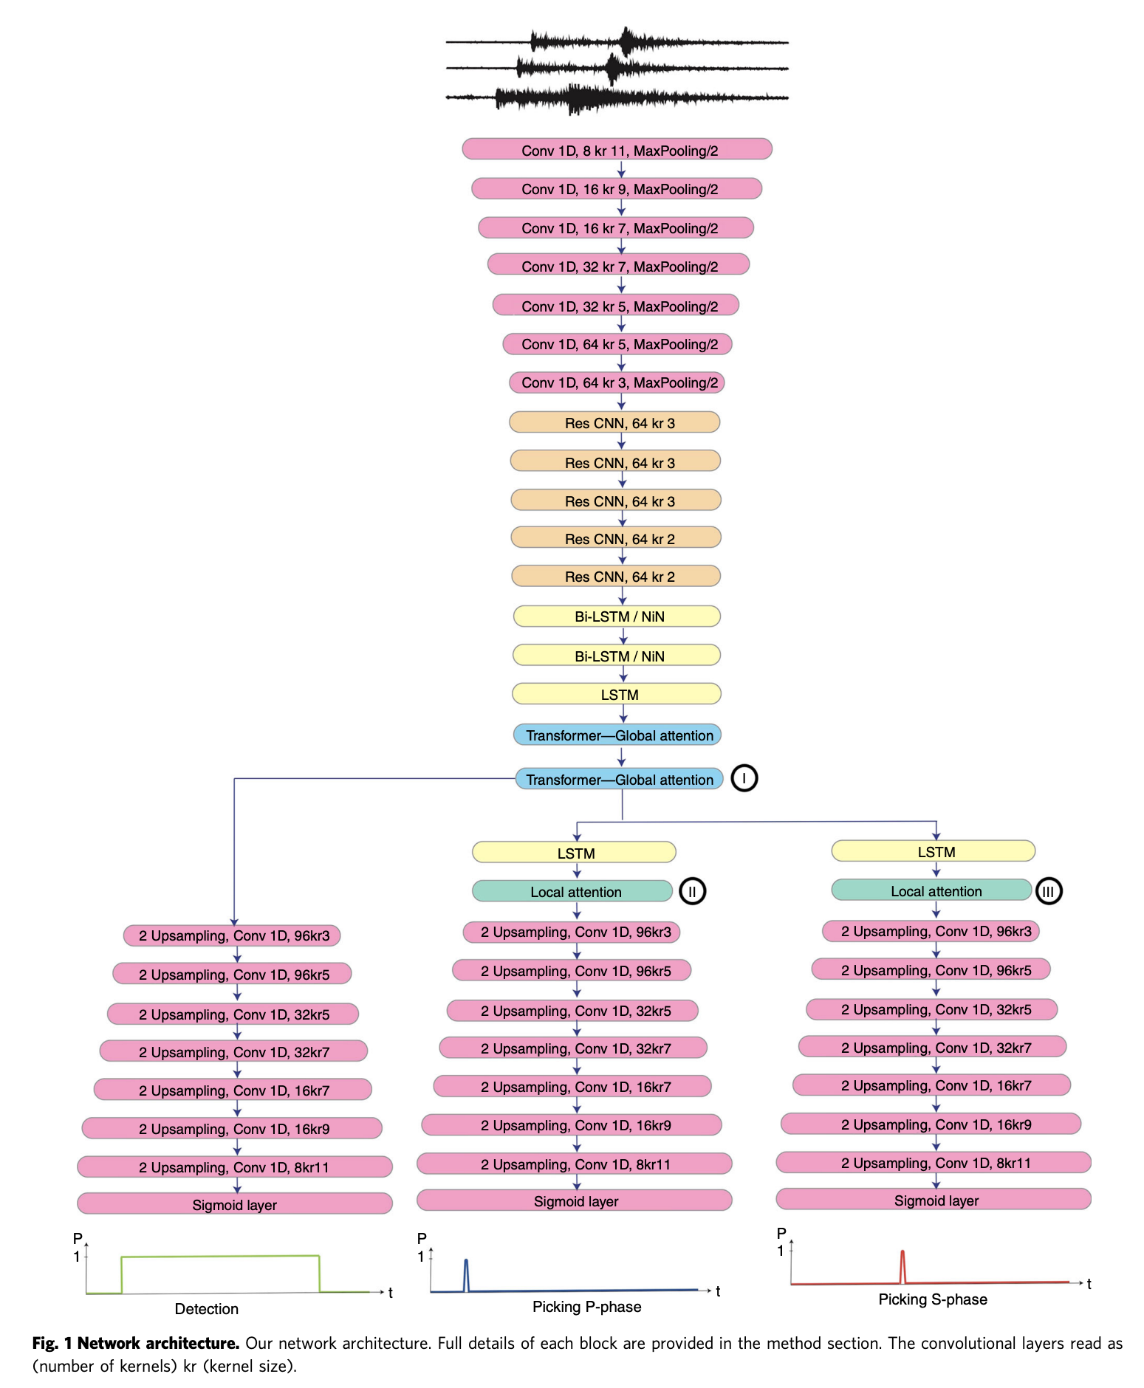
ML workflows
This course will teach you:
Data Prep and exploration
Model Development
Model training
Model Performance evaluation
Model testing out of domain
Marine Denolle mdenolle@uw.edu
Mousavi et al, 2020

Slide 40
We will learn tools
Learn about Data Science and Machine Learning as tools to address geoscientific problems.
This course has a bit of everything:
Open Science Ethics and Practices
Data Manipulation
Statistical Learning
Machine Learning
Computing skills
Overview of what Machine Learning has brought to the Geosciences
Marine Denolle mdenolle@uw.edu

Slide 41
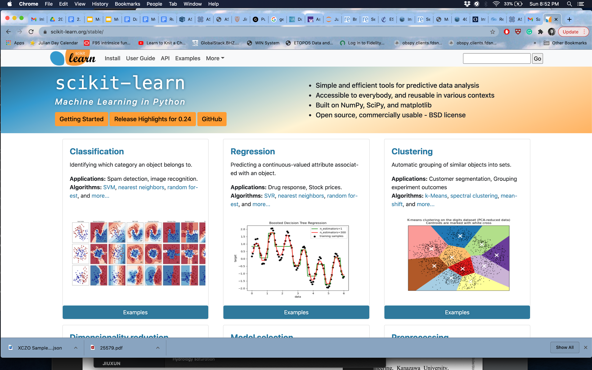




Marine Denolle mdenolle@uw.edu

Slide 42
An outline of the syllabus
Module 1 (week 1) Open-GeoScience Ecosystem
Module 2 (weeks 2-4) AI-ready Data Sets
Module 3 (weeks 5-6) Classic Machine Learning
Module 4 (weeks 7,8,9) Deep Learning
Marine Denolle mdenolle@uw.edu

Slide 43
Reading and webinar assignments
½ page report on papers or webinar recommended. PDFs are due Wednesdays at 11:59 pm PDT on canvas. Marine and Akshay will spend 15 minutes on Monday morning to summarize the reading and webinar reports.
Upload the paper PDF on the class Gdrive.
Update the MLGeo bibliography.
Upload your report on Canvas as an assignment.
569s: report is weekly!
469s: 4 out of 8 reports are due, so biweekly!
Marine Denolle mdenolle@uw.edu

Slide 44
Resources: entry level
Software Carpentries:
https://software-carpentry.org/lessons/
Unix: https://swcarpentry.github.io/shell-novice/
Python: https://swcarpentry.github.io/python-novice-inflammation/
Plotting in Python: http://swcarpentry.github.io/python-novice-gapminder/
Marine Denolle mdenolle@uw.edu

Slide 45

Resources
Open-access main course resources:
Deep Dive into Deep Learning [pytorch+tensorflow]
Earth Data Science at CU Boulder
project: https://geo-smart.github.io
We are writing a book!
https://geo-smart.github.io/curriculum
Marine Denolle mdenolle@uw.edu

Slide 46
Integration of Generative AI in your work
ChatGPT is amazing, and often flawed.
!!! Strong recommendation !!!:
chatGPT for python codes.
Integrate CoPilot (https://github.com/features/copilot/) in VsCode
You will save days of work.
This is not a software engineering or programming class, this is an ML & Geo class.
Marine Denolle mdenolle@uw.edu

Slide 47
Integration of Generative AI in your work
ChatGPT can be your assistant (but do not trust it always)
Policy
Use the syllabus rubrics and snippets of your work (e.g., a PDF of your report / slides, or snippets of codes) and ask chatGPT to grade it.
copy the report and post it on canvas while submitting your project updates. Submit it as gpt_report_1.pdf
Improve on your work until it gives a good grade.
Submit it as gpt_report_2.pdf , with your annotation on how you think it got it right or wrong, to demonstrate that you used it to improve your work.
Then we (humans) grade it.
Marine Denolle mdenolle@uw.edu

Slide 48
The final project
569 students: will lead a project.
469 students: will assist with a 569 project.
The final project will be a research-style project that will leverage the materials covered and apply them to new data in geosciences.
The team will provide a brief progress report (½ page PDF to submit on canvas), a github repository, a 15-min presentation.
Marine Denolle mdenolle@uw.edu

Slide 49
Examples of previous successful projects
Machine learning algorithm to detect oceanographic eddies.
Assessing the performance of land-based Convolutional Neural Network (CNN) phase pickers on offshore seismic data.
Automated detection of pingos in northern Alaska using CNNs.
Upscaling flow direction from fine scale DEM to hydrological grid.
Prediction of Ph measurements at depth using Glider data, trained on previous cruises and using
Timber species identification using random forest
Marine Denolle mdenolle@uw.edu

Slide 50
Course communication
Canvas website: https://canvas.uw.edu/courses/XX
Github organization: https://github.com/UW-MLGEO/
Geosmart slack channel: #mlgeo
Materials will be posted in the form of notebooks.
Emailing policy: We will prioritize responding to email the hour after class and office hours.
Announcements will be posted on Canvas & Slack.
Marine Denolle mdenolle@uw.edu

Slide 51
Grading
 | 469 | 569
Reading and webinar assignments | 15% | 20%
Homework | 45% | 40%
Final project | 30% | 30%
Quizzes | 10% | 10%
All assignments must be turned in for a passing grade.
Marine Denolle mdenolle@uw.edu

Slide 52
Let’s get started!
Sign up to the Slack channel
Sign up for a free Github account, and CoPilot
Use the private messaging on Zoom Chat to give me your Github username to be added to the Github organization.
Install VsCode
Check that you can log-in to the jupyter hub.
Check Canvas, syllabus
Marine Denolle mdenolle@uw.edu

